Slide 1
Technological Landscape:
Insights from the Stack Overflow
Tag Network
By Garrett Xue

Slide 2
Motivation
How do technologies relate within the vast ecosystem of software development?
Which technologies serve as linchpins in the developer community?
What can the interconnectivity of technology tags on Stack Overflow reveal about the evolving landscape of programming?

Slide 3
Data
Data Source: Stack Overflow Developer Stories via Kaggle
Structure: Composed of 'stack_network_links' for tag correlations and 'stack_network_nodes' for tag details
Significance: Illuminates the collaborative framework of technology use
Goal: To decode the trends and core technologies prevalent among data science practitioners

Slide 4
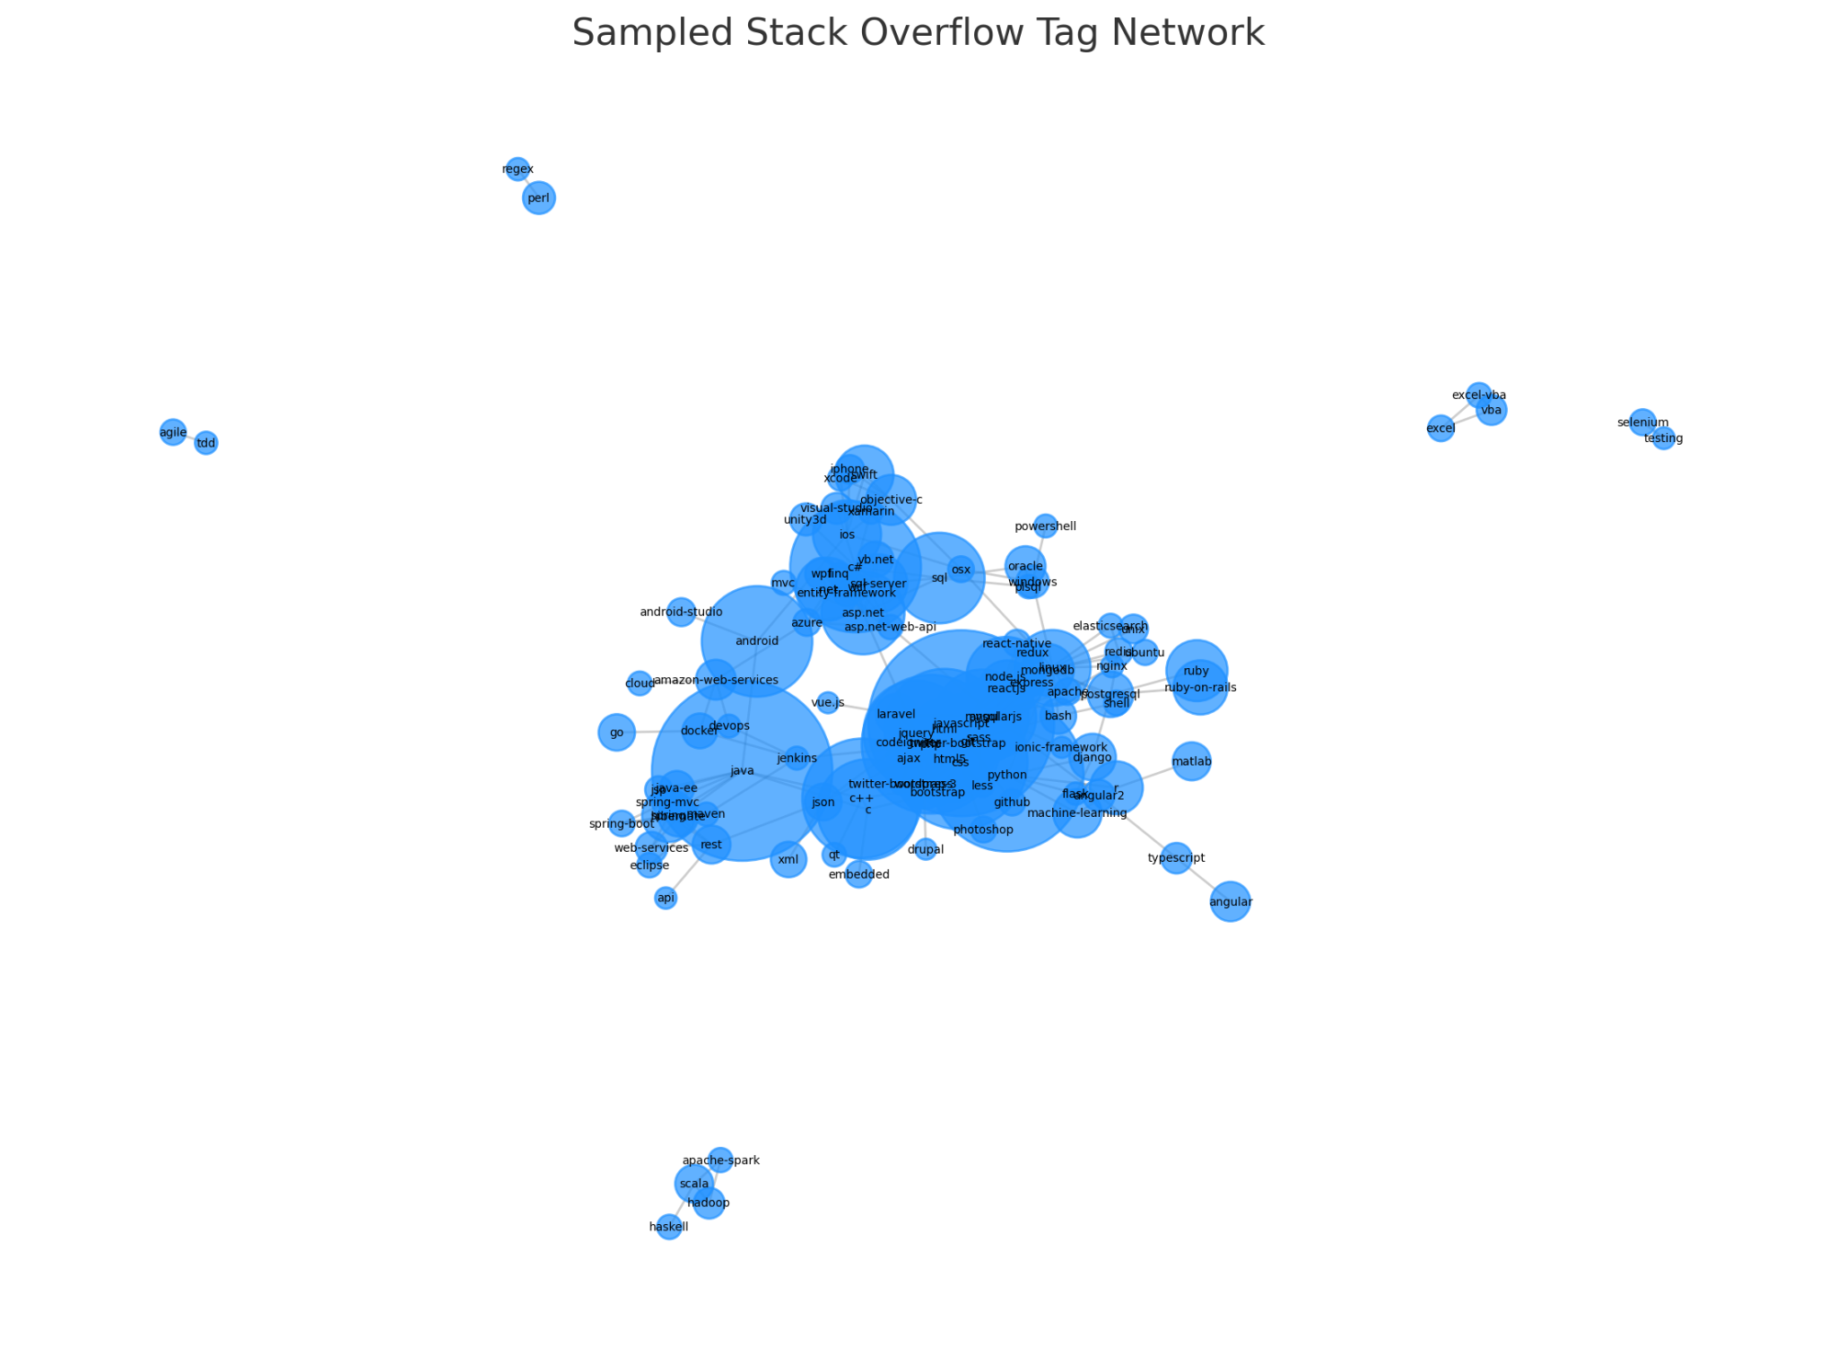
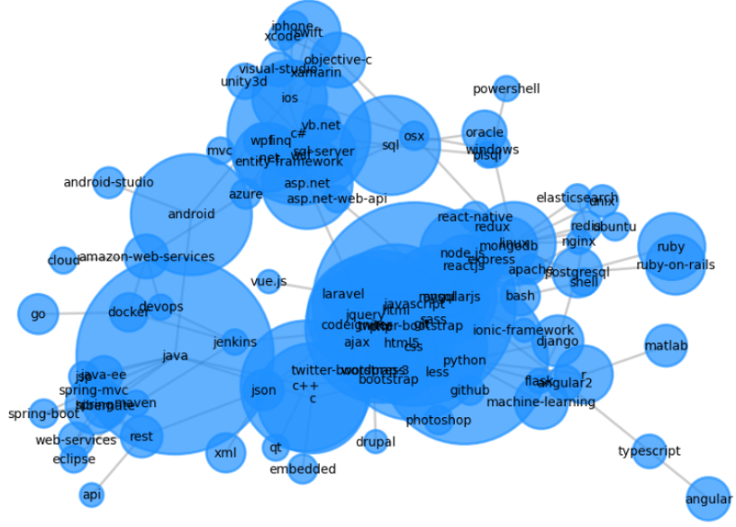
Zooming in →
Interconnected Web:
A Glimpse into the Stack Overflow Tech Ecosystem
Key nodes such as 'JavaScript' and 'Python' emerge as pivotal hubs, underlining their ubiquitous role across diverse technological domains

Slide 5
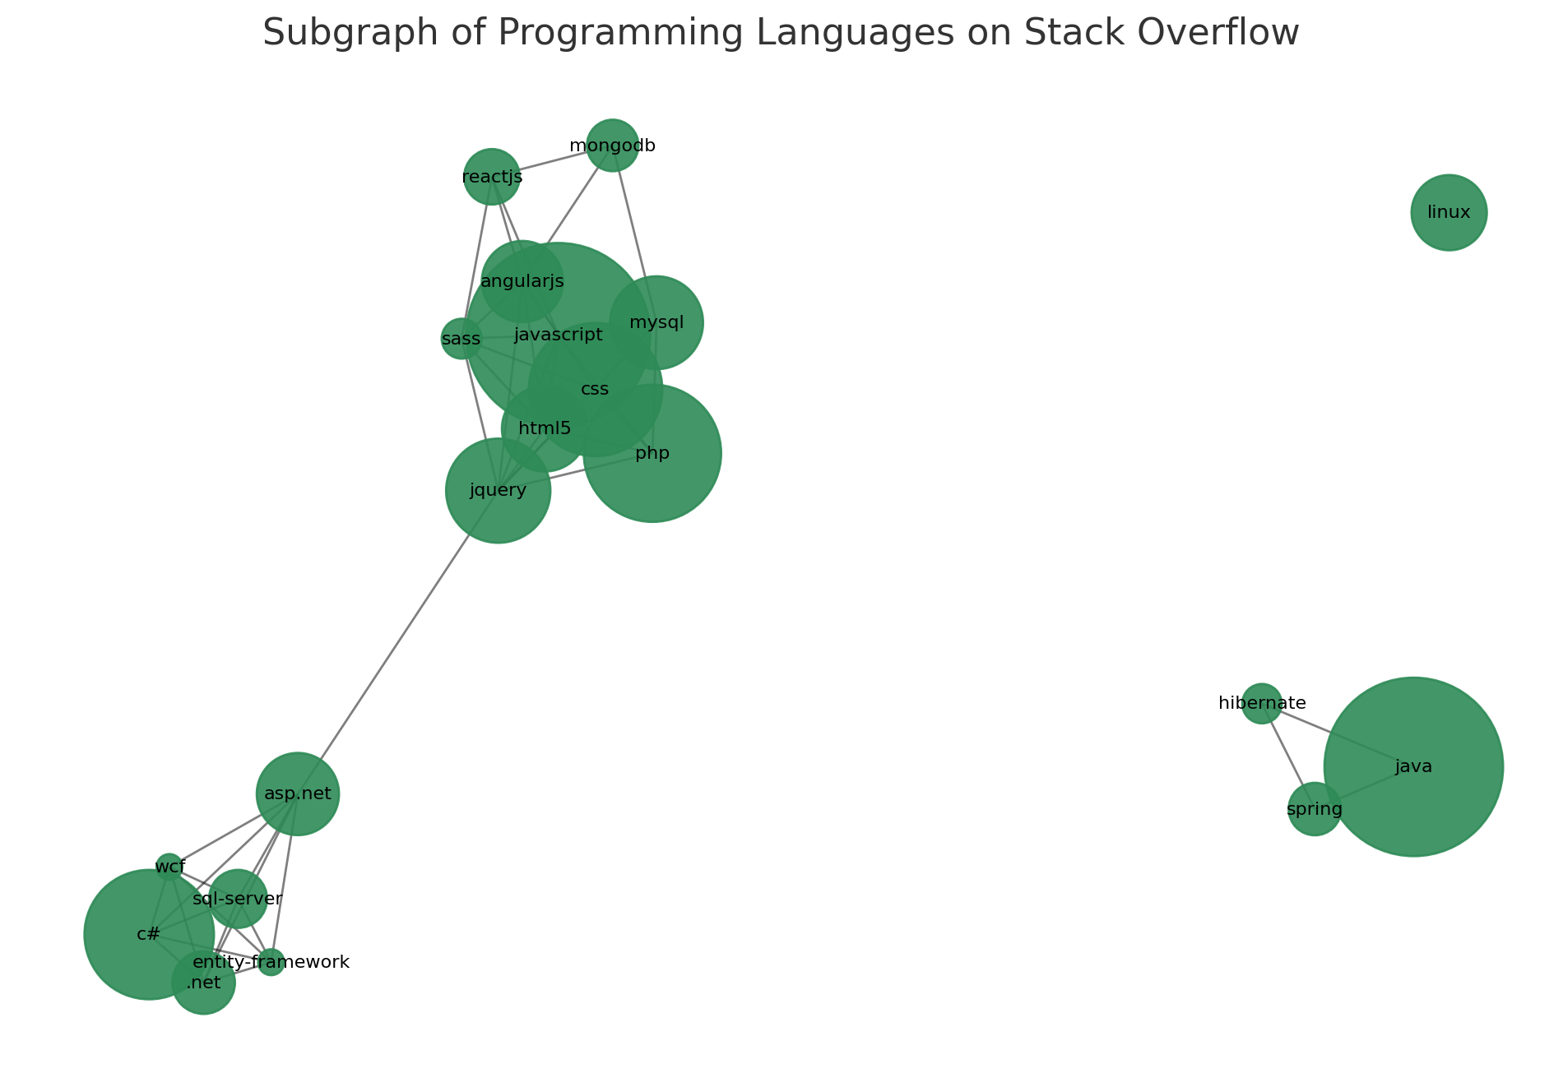
Synergy Among Languages:
The Programming Languages Sub-Network
The tight-knit cluster around 'Java' and 'C#' reveals a significant overlap in developer skill sets, while the adjacency of 'Go' indicates its rising relevance
Offers a perspective on how foundational languages intertwine with emerging ones, shaping the developer's landscape

Slide 6
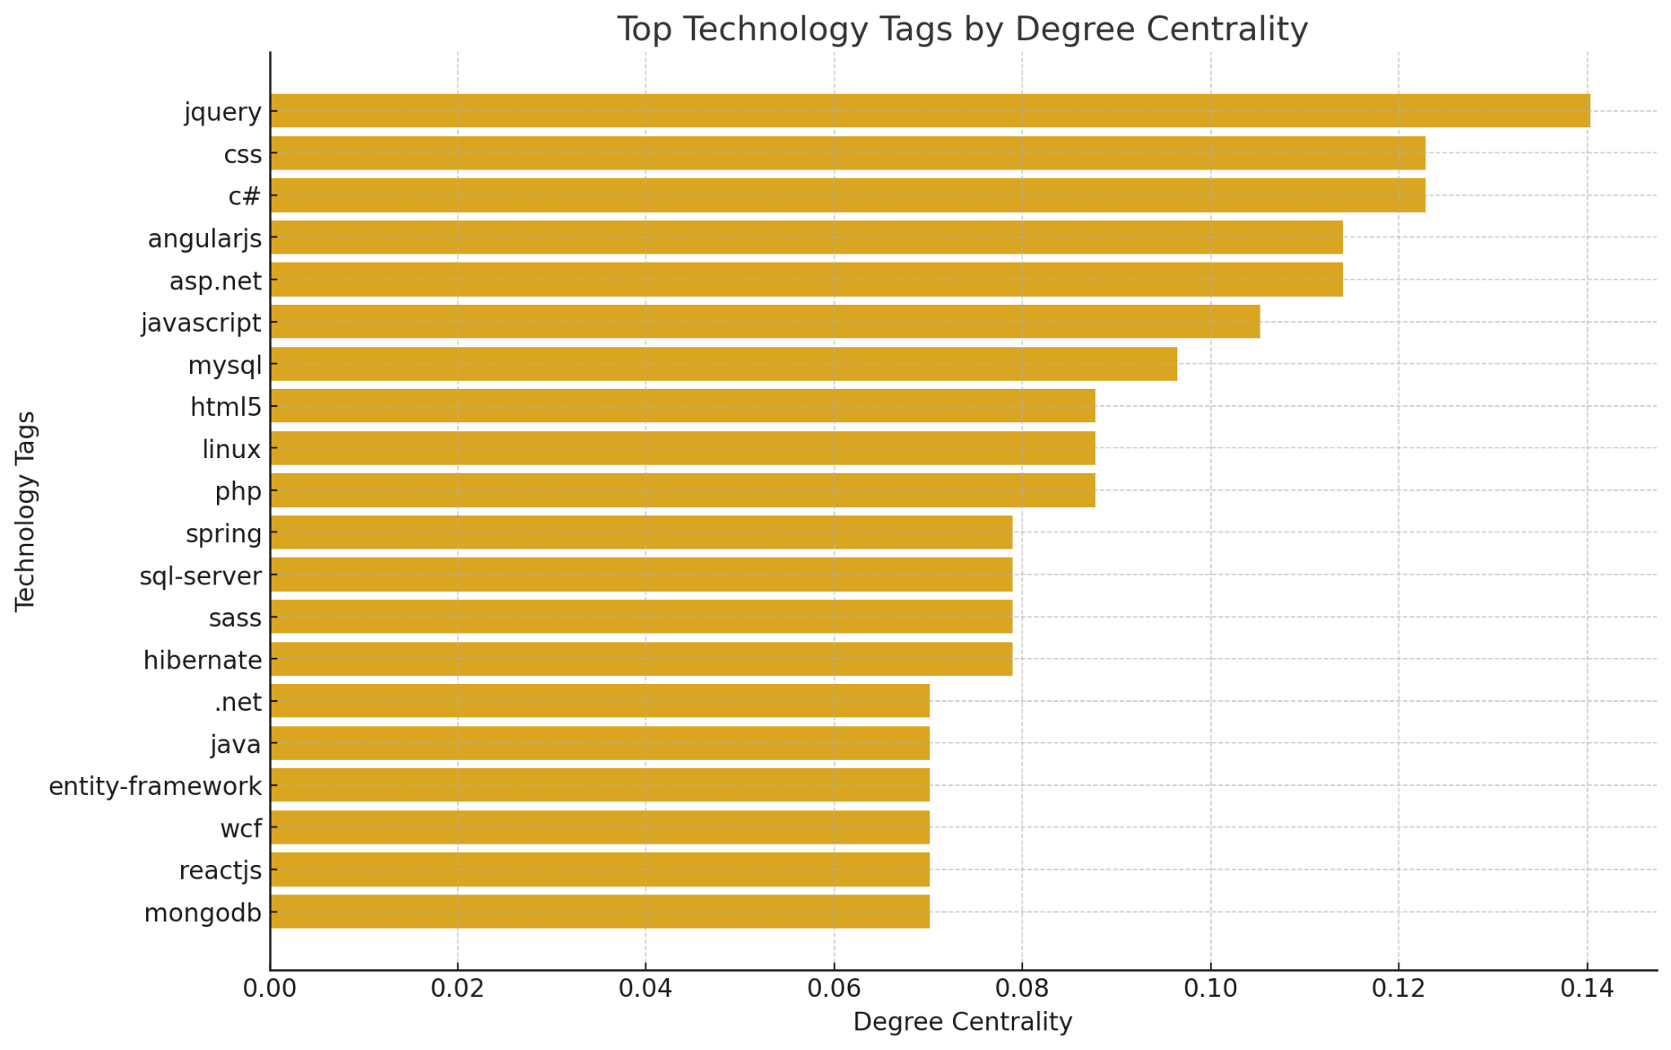
Influencers of the Tech World: Tags with the Highest Degree Centrality
JavaScript's' and 'HTML's’ high centrality underscores its status as a cornerstone in web development, pivotal for connecting a myriad of other technologies
'SQL' and 'CSS' follow closely, reflecting their integral use in database management and web design

Slide 7
Takeaway
Key Findings: Central hubs like JavaScript and Python dictate the network's structure.
Trends: There is a harmonious blend of established and emerging technologies.
Implications: Understanding these connections is crucial for strategic learning and professional growth in data science.
Conclusion: The Stack Overflow Tag Network is a reflection of the dynamic, interconnected nature of the technology space in which data scientists operate.

